Slide 1
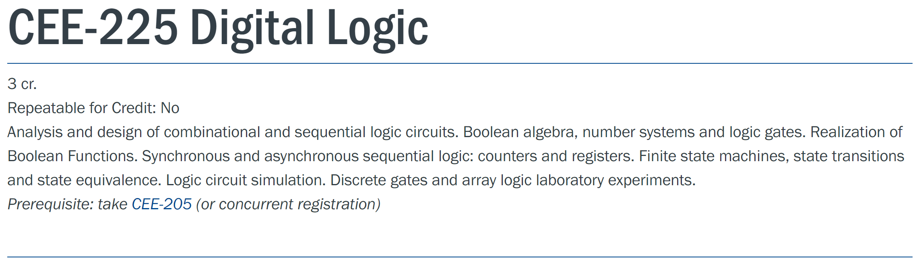
Welcome to CEE 225
Dr. Yuan Xing

Slide 2



Course Instructor (Short Biography)
Yuan Xing
Education
Ph.D. Electrical and Computer Engineering, Baylor University 2020
M.S. Electrical and Computer Engineering, University of Rochester 2016
B.S. Telecommunication Engineering, Beijing Jiaotong University 2014
Areas
5G Communication advanced system designs
Deep Learning
Advanced Digital Signal Processing
Projects
Hyperspectral image processing, FCW
Artificial intelligent wireless power transfer system, UW Stout & Wisys
COVID-19 Healthcare AI advanced system, UW Stout & UW Madison & Marshfield Clinic
Developing an easy-to-apply, integrated approach to modeling freshwater contamination from farm runoff using only commercial drones, cameras, and software, Freshwater Collaborative of Wisconsin
Service
IEEE Computing and Communication Workshop and Conference technical committee member
IEEE Information Technology, Electronics and Mobile Communication Conference Deep Learning, Big data session chair

Slide 3
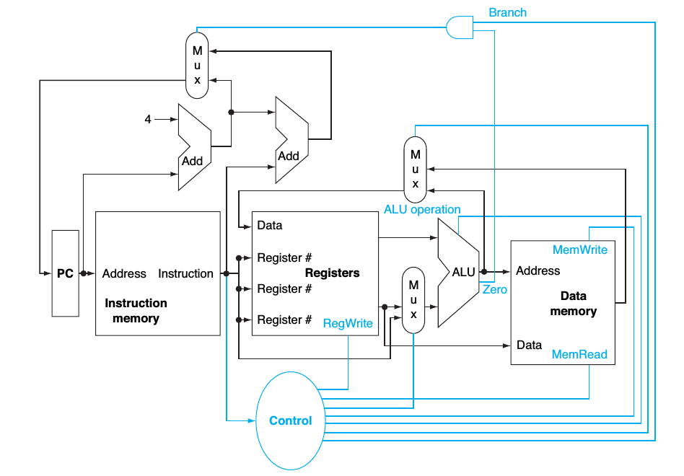
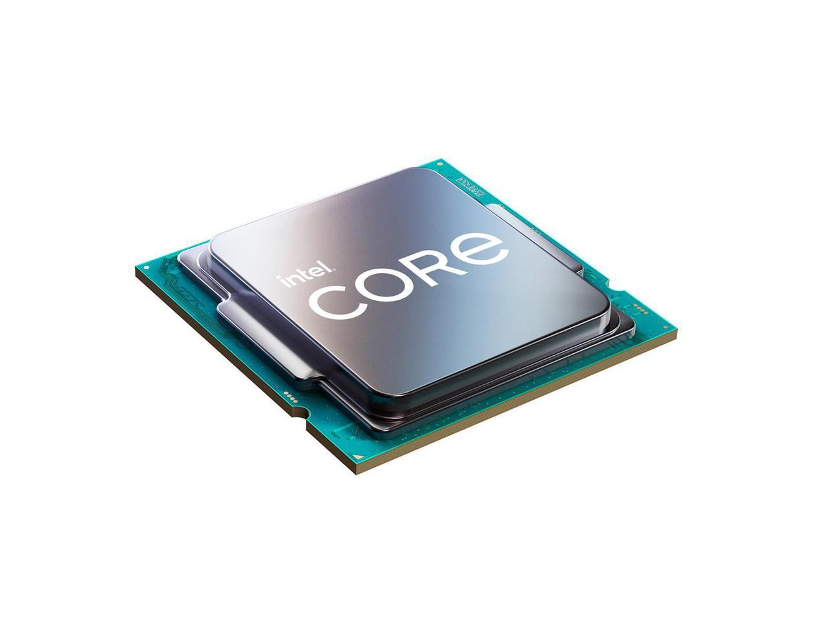
What do we learn in CEE 225?
CPU

Slide 4
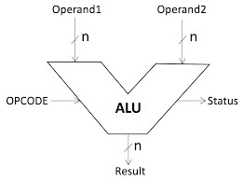
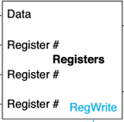
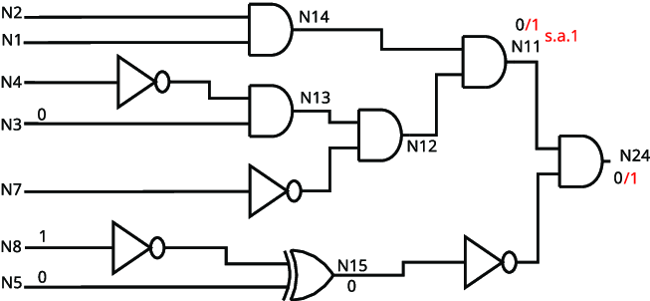
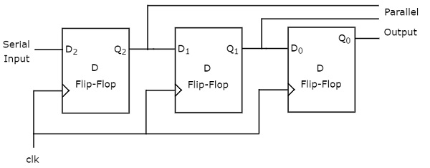
What do we learn in CEE 225?
ALU
Register

Slide 5
Key points for CEE 225
Understand the basic engineering concepts of digital logic and digital logic systems; both sequential and combinational.
Describe the basic building blocks of digital engineering including AND, OR, NOT, XOR, NOR, NAND, Latch, Flip-flops.
Use the fundamental knowledge to analysis Counters, Adders, Registers, Multiplexers, ALUs.
Understand and use digital reduction techniques using logic mapping methodologies; e.g. Karnaugh Maps.

Slide 6
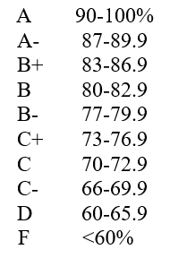
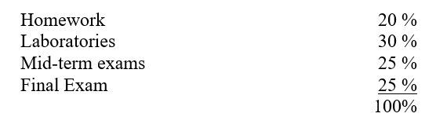
Evaluation in CEE 225
Attendance and Participation is VERY VERY VERY IMPORTANT.

Slide 7
Books for CEE 225
Textbook: Fundamentals of Logic Design, Roth, Charles H, Jr., Kinney, Larry L.
Other supplemental materials:
Introduction to Logic Design, Third Edition, Marcovitz, A., 2010.
Digital Design, Fourth Edition, Mano, M. and Ciletti, M., 2007.

Slide 8
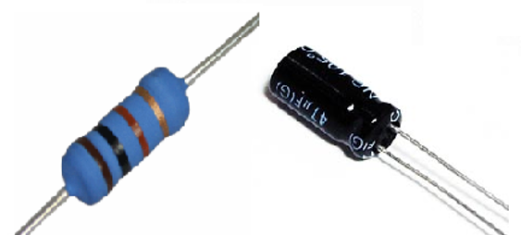
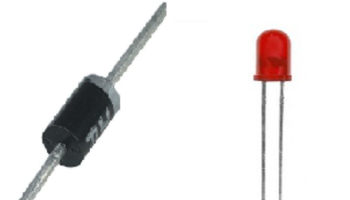
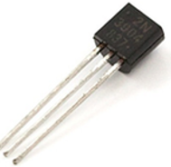
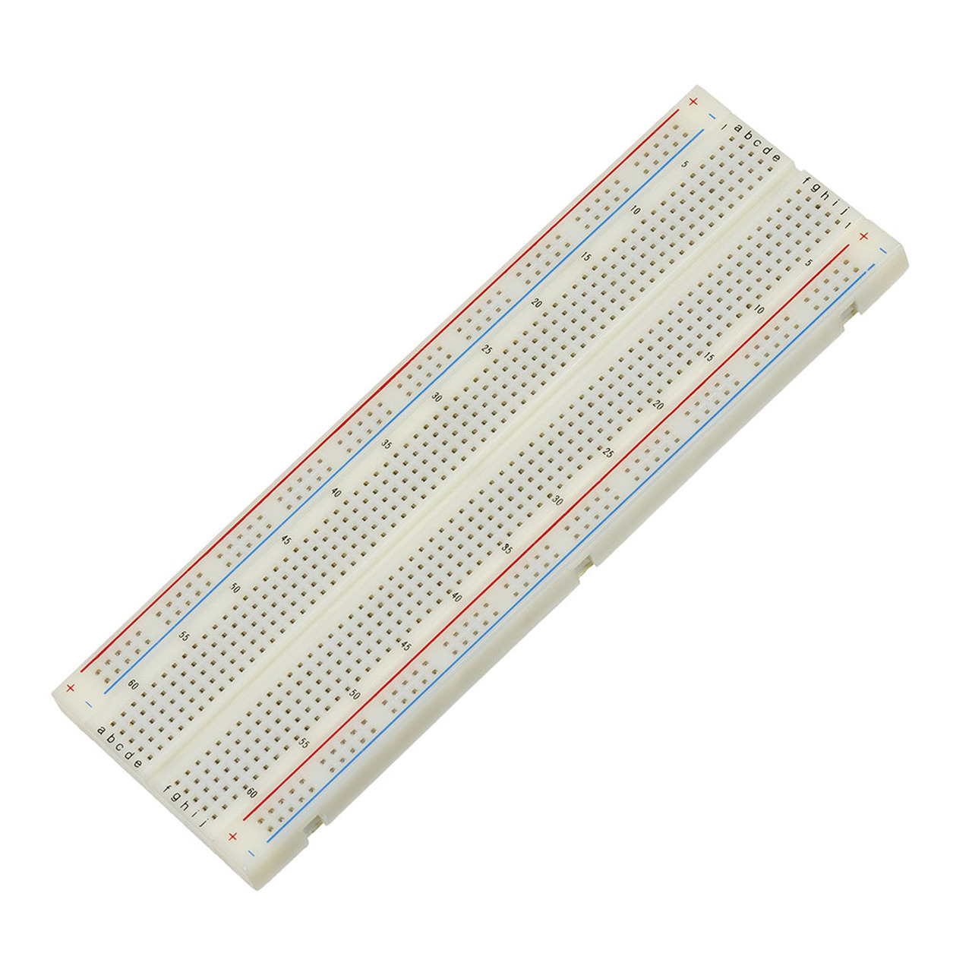

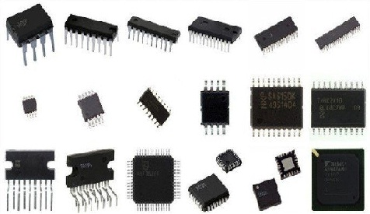
Hardware labs

Slide 9
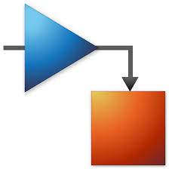
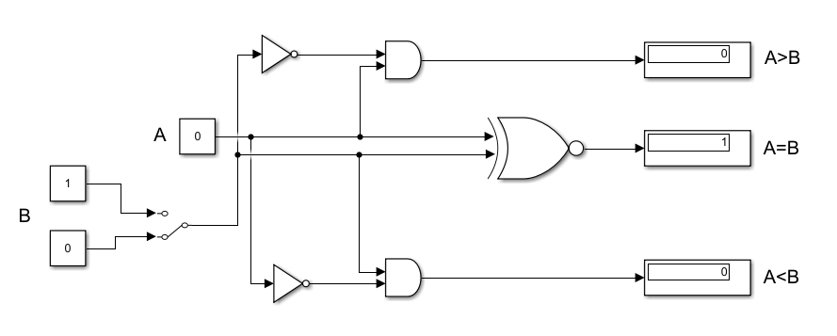
Software labs

Slide 10
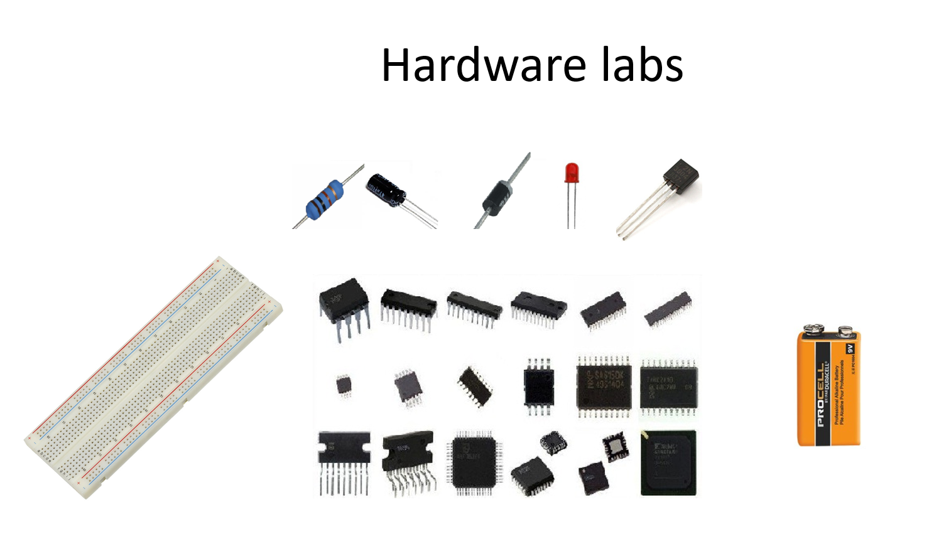
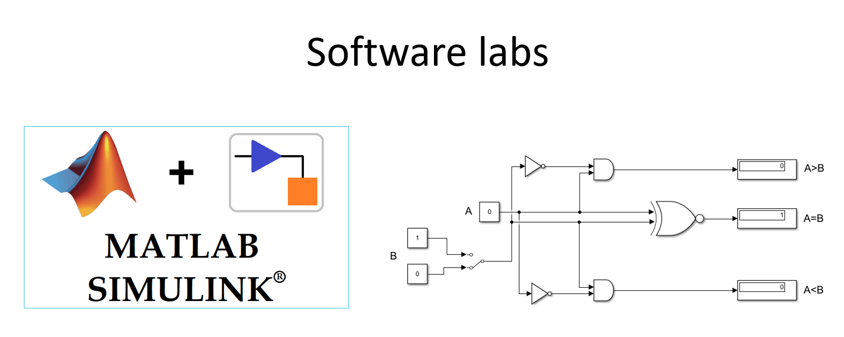
Overall, about 27 Hardware + Software labs

Slide 11
Lecture Rules:
Students are required to attend the classes and do all assignments.
All assignments will have due dates and times.
Attendance is critical for success.
The courses will be recorded so they can be viewed after class too.
From next class, ‘Lecture slides draft’ will be uploaded one day before class for you to preview, ‘Annotated lecture notes’ will be available in Canvas as well.

Slide 12
Lab Rules:
Almost each class has a lab
Bring your laptop to class since next class. Even it’s hardware lab, you can use your laptop to read the instruction easily while doing the labs.
Each student has a lab kits, very few difficult labs are finished by teamwork of two students.
Labs will also be in rooms 201S.
Most labs are checked off in class. If not checked in class, you can upload your results to canvas.

Slide 13

Interesting demonstration- Tough decision maker

Slide 14
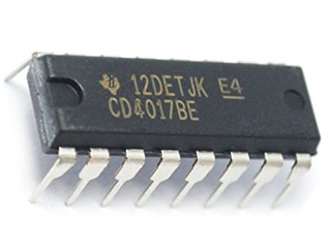
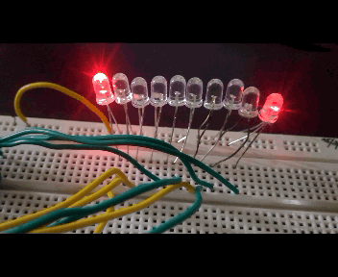
4017 IC
The CD4017 IC is a CMOS Decade counter. This CMOS IC is frequently used in designing the 10 LEDs-based circuits. It counts to 10 & also it includes 10 separate outputs. This IC includes the counter as well as the decoder.

Slide 15
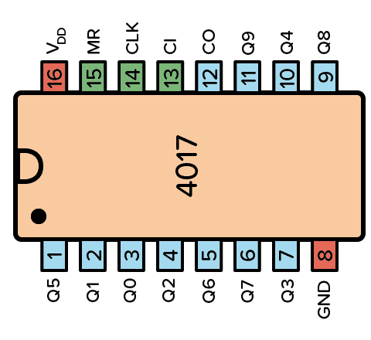
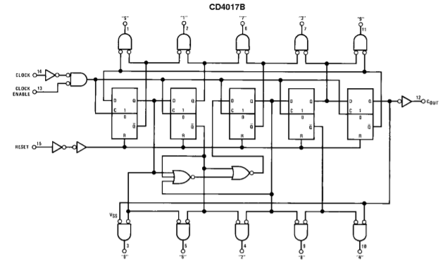
4017 IC

Slide 16
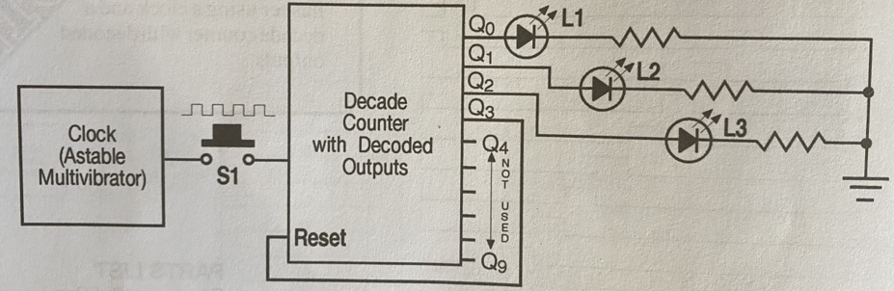
Schematic diagram

Slide 17
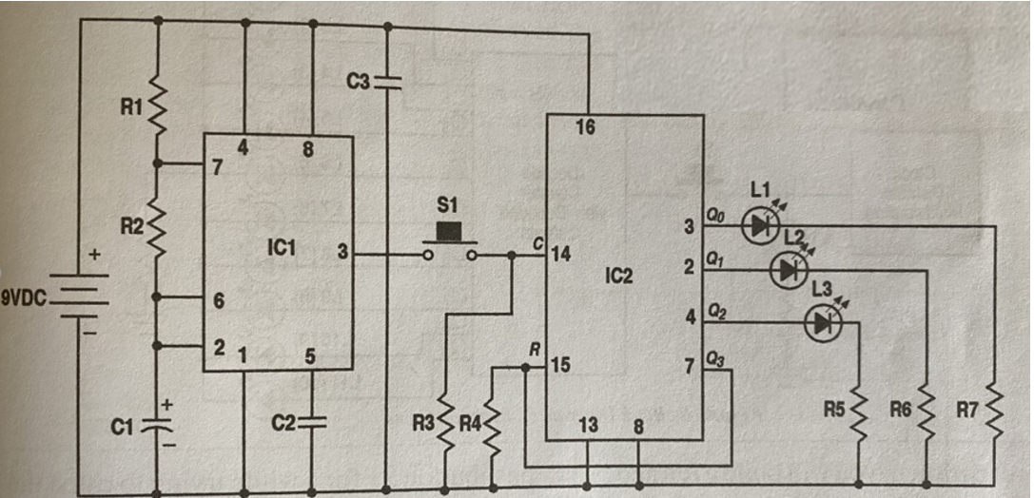
circuit diagram

